Slide 1
Game project presentation
IONUȚ CIOBANU
CGD Level 6
Group 7

Slide 2
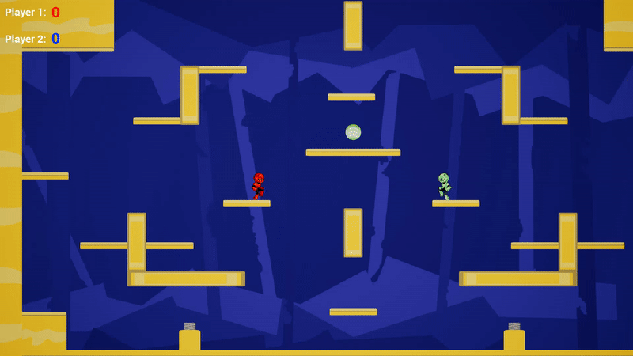
overview
2 players
Competitive
Platform game
PC
HARD FUN

Slide 3
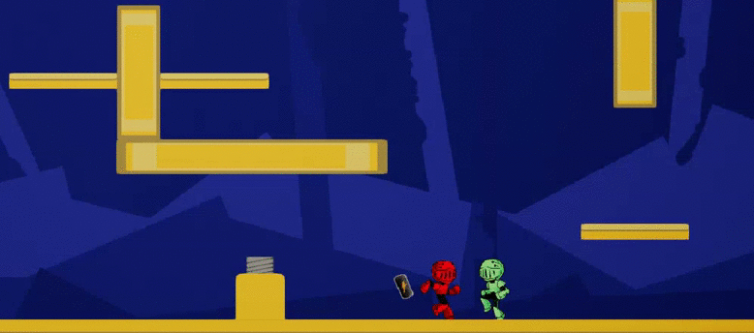
Feedback
Pick-up that increases speed:
It’s a good idea
Could use it as an incentive to direct the player
Add more

Slide 4
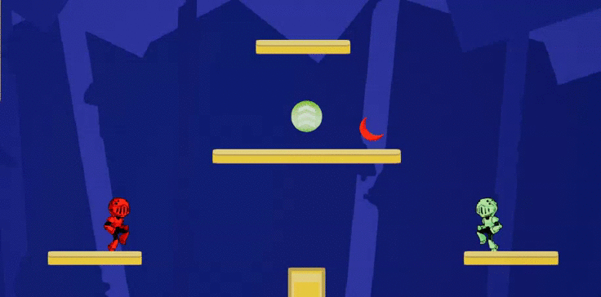
feedback
Boomerang mechanic – the player hit is stopped in place:
‘I like it!’
The projectile should move faster

Slide 5
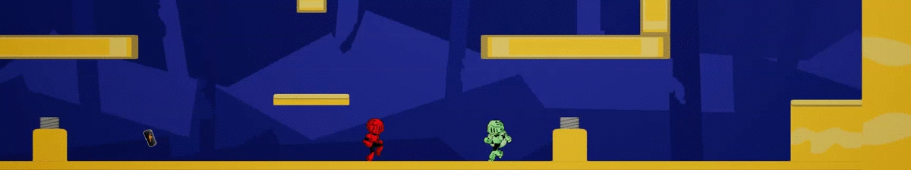
feedback
Moving platforms mechanic – in a pattern:
Players did not initially know which platforms will move and which not
The gates are a bit slow (timing wise)
One player thought it was ‘cool’

Slide 6
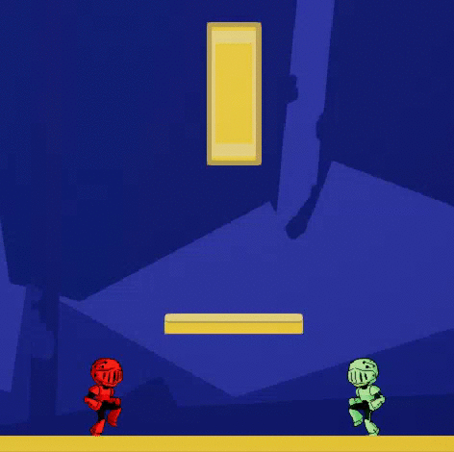
feedback
Jumping:
Inconsistent
It doesn’t feel like a double jump
‘Confused.exe’
Makes the game harder
(Hard fun?)

Slide 7
feedback
Movement speed should be faster – too slow at the moment = boring
The camera is broken – a standard, static camera would do

Slide 8
Timeline for game completion
Further playtest to maximize HARD FUN.
Learn – Practice – Master loop = ? Minutes of gameplay
(competitive game, players will replay levels)
The game will feature, for now, one art complete playable level of 4 rounds with different mechanics.

Slide 9


Timeline
1. | Playtest
2. | Polish
3. | Add main menu / menus
4. | Score screen (end screen)
5. | Sound effects
6. | Visual effects? (FX)
7. | Final adjustments

Slide 10
Thanks for listening!
?
ANY QUESTIONS?

